Slide 1
HW 3: array
Artem

Slide 2
Sprint 1:
Display the mouse and cheese characters. The position is indicated by the variables (x, y) and the size is indicated by the variable d, respectively.
float mx,my,md; // pet
float cx,cy,cd; // artem
void setup() {
size(800, 600);
mx=random(width);
my=random(height);
md=10;
cx=random(width);
cy=random(height);
cd=5;
background(255,244,189);
pet(mx, my, md);
artem(cx, cy, cd);
}
}
void pet(float x,float y, float d){
fill(255,160,60);
circle(x,y,d*10); // face
ellipse(x,y+d,d*5,d*4); // muzzle
fill(0);
ellipse(x,y-0.5*d,d*2,d); // nose
circle(x+d*2,y-d*2,0.5*d); // right eye
circle(x-d*2,y-d*2,0.5*d); // left eye
}
void artem(float x, float y, float d){
fill(255,220,180);
strokeWeight(2);
triangle(x-15*d,y+20*d, x+15*d,y+20*d, x,y); // body
fill(255);
rect(x-5*d,y+9*d,4*d,2*d); // left eye
rect(x+1*d,y+9*d,4*d,2*d); // right eye
stroke(0);
line(x+1*d,y+8*d,x+5*d,y+8*d); // eyebrow right
line(x-5*d,y+8*d,x-1*d,y+8*d); // eyebrow left
fill(40,150,180);
circle(x-2.7*d,y+10*d,1.4*d); // pupil left
circle(x+3.4*d,y+10*d,1.6*d); // pupil right
fill(255);
ellipse(x,y+16*d,8*d,3*d); // mouth
fill(240);
rect(x-0.5*d,y+14.6*d,1.5*d,2*d); // tooth
}

Slide 3
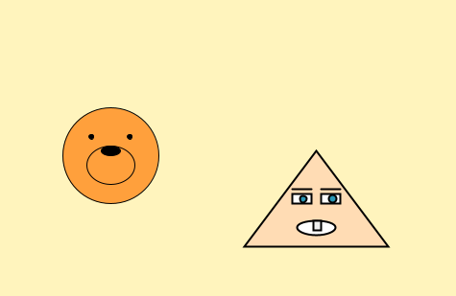

Slide 4
Sprint 2
Make the two objects bounce and move when they collide with the left and right walls and the top and bottom walls.
Variables: Add a velocity vector (vx, vy).
Functions:
Implement movement using draw().
Add moveMouse() and moveCheese() to move each object..

Slide 5
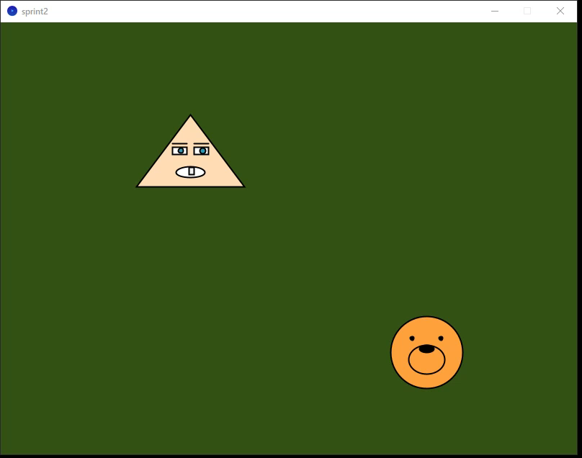
Sprint 2:
float mx,my,md,mvx,mvy; // pet
float cx,cy,cd,cvx,cvy; // artem
// artem
void setup() {
size(800, 600);
mx = random(width);
my = random(height);
mvx = random(3,6);
mvy = random(3,6);
md = 10;
cx = random(width);
cy = random(height);
cd = 5;
cvx = random(3,6);
cvy = random(3,6);
background(255,244,189);
pet(mx, my, md);
artem(cx, cy, cd);
}
void draw(){
background(50,80,20);
moveMouse();
moveCheese();
pet(mx,my,md);
artem(cx,cy,cd);
}
void moveMouse(){
mx += mvx;
my += mvy;
if(mx>width-50 || mx<50) mvx = -mvx;
if(my>height-50 || my<50) mvy = -mvy;
}
void moveCheese(){
cx += cvx;
cy += cvy;
if(cx>width-50 || cx<50) cvx = -cvx;
if(cy>height-50 || cy<50) cvy = -cvy;
}

Slide 6
Sprint 3
Sprint 3: Change the color when they collide with the left and right walls, and shrink when they collide with the top and bottom walls.
Variable: add one more variable for color
Function:
Modify mouse( ) and Cheese( ) for color changing
Modify mouseMove( ) and Cheese( ) for color/size changing

Slide 7
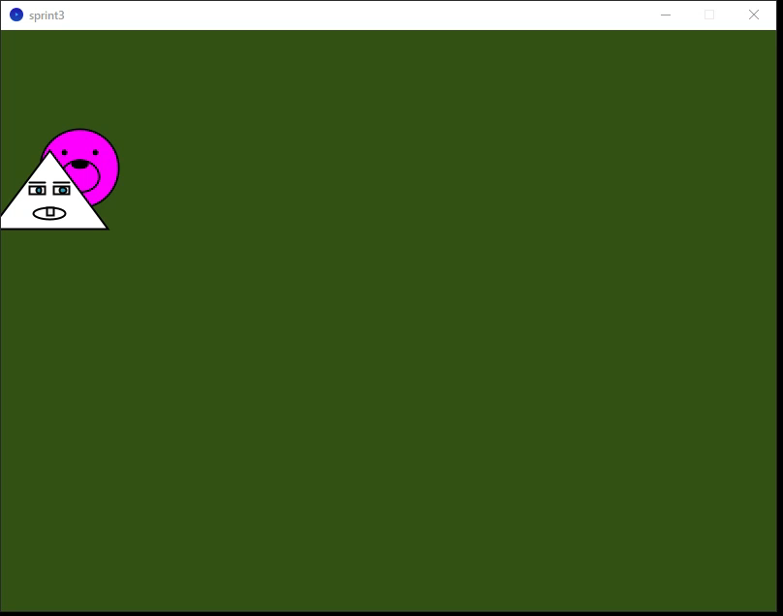
Sprint 3

Slide 8
float mx,my,md,mvx,mvy,mc; // pet
float cx,cy,cd,cvx,cvy,cc; // artem
// artem
void setup() {
size(800, 600);
mx = random(width);
my = random(height);
mvx = random(3,6);
mvy = random(3,6);
md = 10; mc=0;
cx = random(width);
cy = random(height);
cd = 5;cc=0;
cvx = random(3,6);
cvy = random(3,6);
background(255,244,189);
pet(mx, my, md);
artem(cx, cy, cd);
}
void draw(){
background(50,80,20);
moveMouse();
moveCheese();
pet(mx,my,md);
artem(cx,cy,cd);
}
void moveMouse() {
mx += mvx;
my += mvy;
if (mx > width - 50) { mx = width - 50; mvx = -abs(mvx); mc = 1 - mc; }
else if (mx < 50) { mx = 50; mvx = abs(mvx); mc = 1 - mc; }
if (my > height - 50){ my = height - 50; mvy = -abs(mvy); md *= 0.9; }
else if (my < 50) { my = 50; mvy = abs(mvy); md *= 0.9; }
}
void moveCheese() {
cx += cvx;
cy += cvy;
if (cx > width - 50) { cx = width - 50; cvx = -abs(cvx); cc = 1 - cc; }
else if (cx < 50) { cx = 50; cvx = abs(cvx); cc = 1 - cc; }
if (cy > height - 50){ cy = height - 50; cvy = -abs(cvy); cd *= 0.9; }
else if (cy < 50) { cy = 50; cvy = abs(cvy); cd *= 0.9; }
}
void pet(float x,float y, float d){
if(mc == 0) fill(255, 255, 0);
else fill(255,0,255);
circle(x,y,d*10); // face
ellipse(x,y+d,d*5,d*4); // muzzle
fill(0);
ellipse(x,y-0.5*d,d*2,d); // nose
circle(x+d*2,y-d*2,0.5*d); // right eye
circle(x-d*2,y-d*2,0.5*d); // left eye
}
void artem(float x, float y, float d){
if(cc == 0) fill(255); else fill(120);
strokeWeight(2);
triangle(x-15*d,y+20*d, x+15*d,y+20*d, x,y); // body
fill(255);
rect(x-5*d,y+9*d,4*d,2*d); // left eye
rect(x+1*d,y+9*d,4*d,2*d); // right eye
stroke(0);
line(x+1*d,y+8*d,x+5*d,y+8*d); // eyebrow right
line(x-5*d,y+8*d,x-1*d,y+8*d); // eyebrow left
fill(40,150,180);
circle(x-2.7*d,y+10*d,1.4*d); // pupil left
circle(x+3.4*d,y+10*d,1.6*d); // pupil right
fill(255);
ellipse(x,y+16*d,8*d,3*d); // mouth
fill(240);
rect(x-0.5*d,y+14.6*d,1.5*d,2*d); // tooth
}

Slide 9
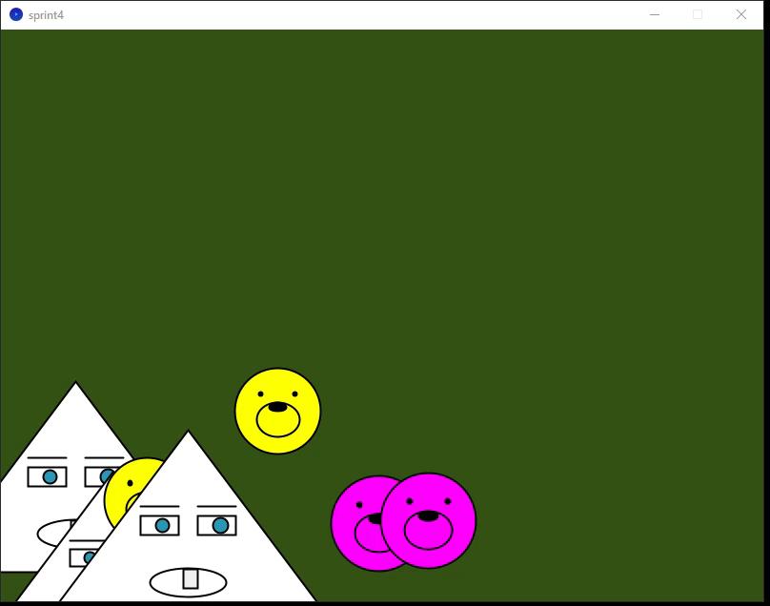
Sprint 4

Slide 10
float []mx,my,md,mvx,mvy; // pet
int []mc;
float []cx,cy,cd,cvx,cvy;// artem
int []cc;
int N=5;
void setup() {
size(800, 600);
mx = new float[N];
my = new float[N];
mvx = new float[N];
mvy = new float[N];
md = new float[N]; mc=new int[N];
cx = new float[N];
cy = new float[N];
cd = new float[N]; cc=new int[N];
cvx = new float[N];
cvy = new float[N];
initialize(mx, my, mvx, mvy, md, mc);
initialize(cx, cy, cvx, cvy, cd, cc);
}
void draw(){
background(50,80,20);
moveMouse();
moveCheese();
for (int i=0; i<N; i++) {
pet(mx[i], my[i], md[i], mc[i]);
artem(cx[i], cy[i], cd[i], cc[i]);
}
}
void moveObject(float[] x, float[] y,
float[] vx, float[] vy, float[] d, int[] c) {
for (int i=0; i<N; i++) {
if (x[i]>width-50 || x[i]<50) {
vx[i] = -vx[i];
c[i] = (++c[i] % 2);
}
if (y[i]>height-50 || y[i]<50) {
vy[i] = -vy[i];
d[i] *= 0.9;
}
x[i] += vx[i];
y[i] += vy[i];
}
}
void initialize(float[] x, float[] y,
float[] vx, float[] vy, float[] d, int[] c) {
for (int i=0; i<N; i++) {
x[i] = random(width);
y[i] = random(height);
d[i] = 10;
c[i] = 0;
vx[i] = random(-6, -3);
vy[i] = random(3, 6);
}
}

Slide 11
Feeling (and question)
Feeling
Unifying both functions into one saved code and reduced repetition.
I learned how arrays can handle multiple objects efficiently.
Question
Some objects stay near a wall and can't escape. Why is that?
Answer: They get stuck because the position isn’t corrected after bouncing, so the object keeps flipping direction every frame.

Slide 12
Extra
What would you do if you added Sprint 5? Write down your idea and you'll get a bonus of up to 5 points. Implementing it will earn you a bonus of up to 5 points.
Idea: I would add random color or speed changes every time an object bounces off a wall. It would make the movement look more dynamic and unpredictable.

Slide 13
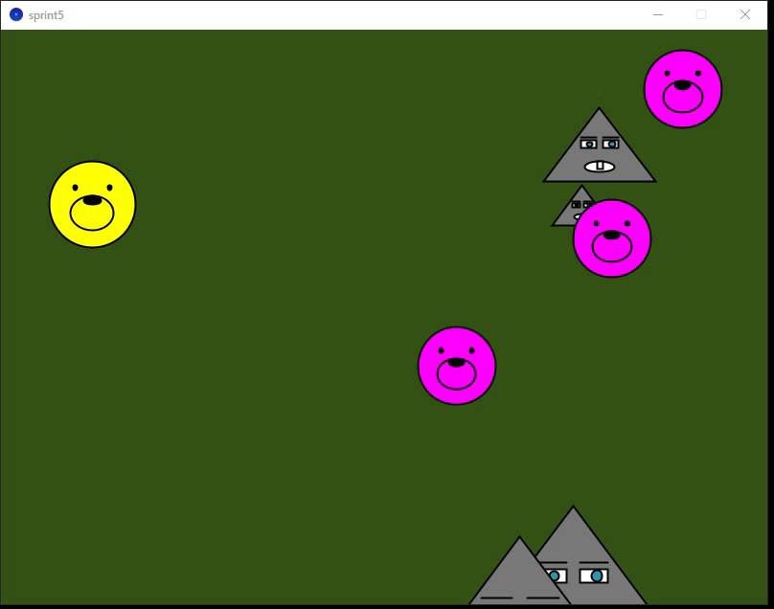
Sprint 5

Slide 14
void moveObject(float[] x, float[] y,
float[] vx, float[] vy, float[] d, int[] c) {
for (int i = 0; i < N; i++) {
if (x[i] > width - 50 || x[i] < 50) {
vx[i] = -vx[i];
c[i] = int(random(2)); // random color
vx[i] *= random(0.8, 1.3); // random speed change
}
if (y[i] > height - 50 || y[i] < 50) {
vy[i] = -vy[i];
d[i] *= 0.9;
c[i] = int(random(2)); // also change color
vy[i] *= random(0.8, 1.3); // and random speed
}
x[i] += vx[i];
y[i] += vy[i];
}
}

Slide 15
All source code
The full project is uploaded to GitHub: https://github.com/brevno-project/Java

